Slide 1
Personal Projects
A Story About How I Got Into Woodworking
And The Reason Behind the Design of Some Projects

Slide 2
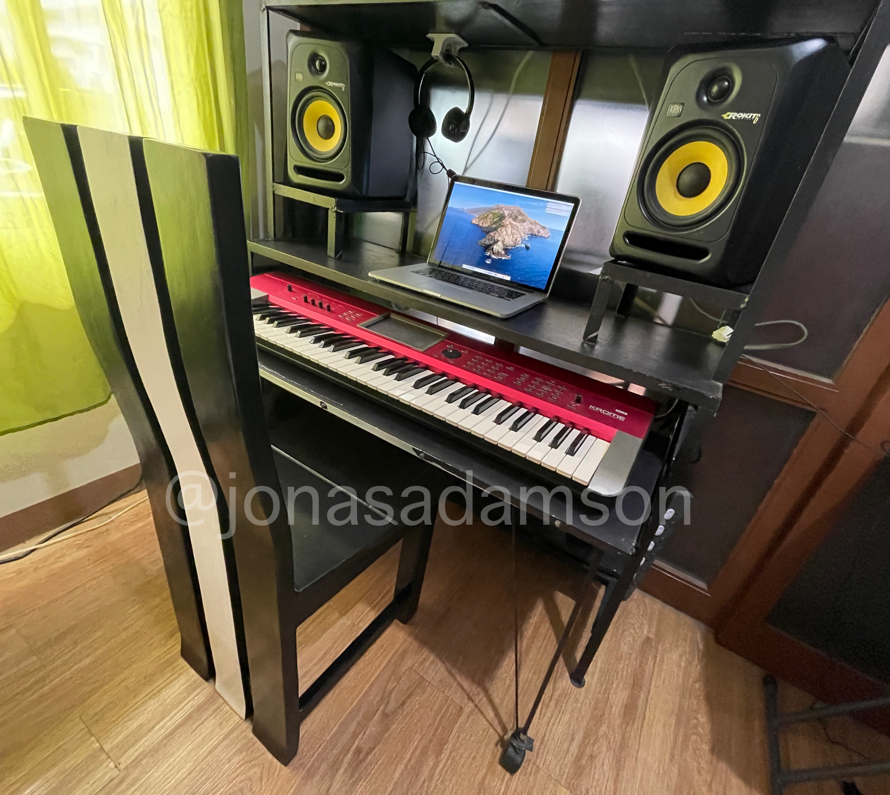
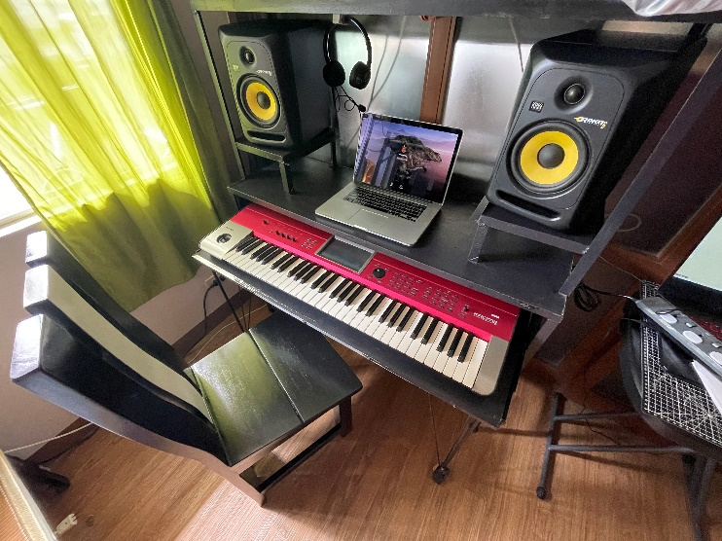
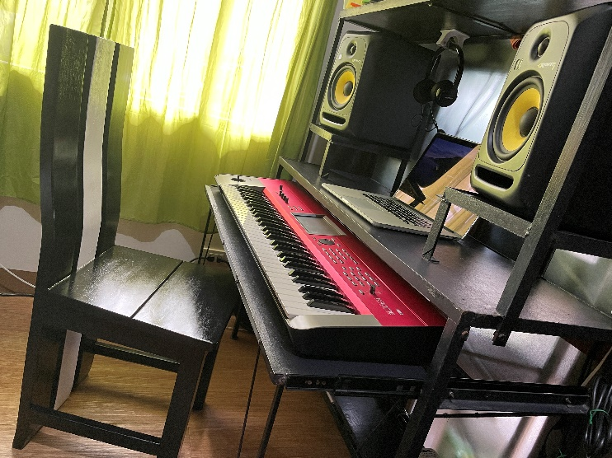
Notes:
First custom designed table
Keyboard tray, monitor speakers stand, computer desk

Slide 3
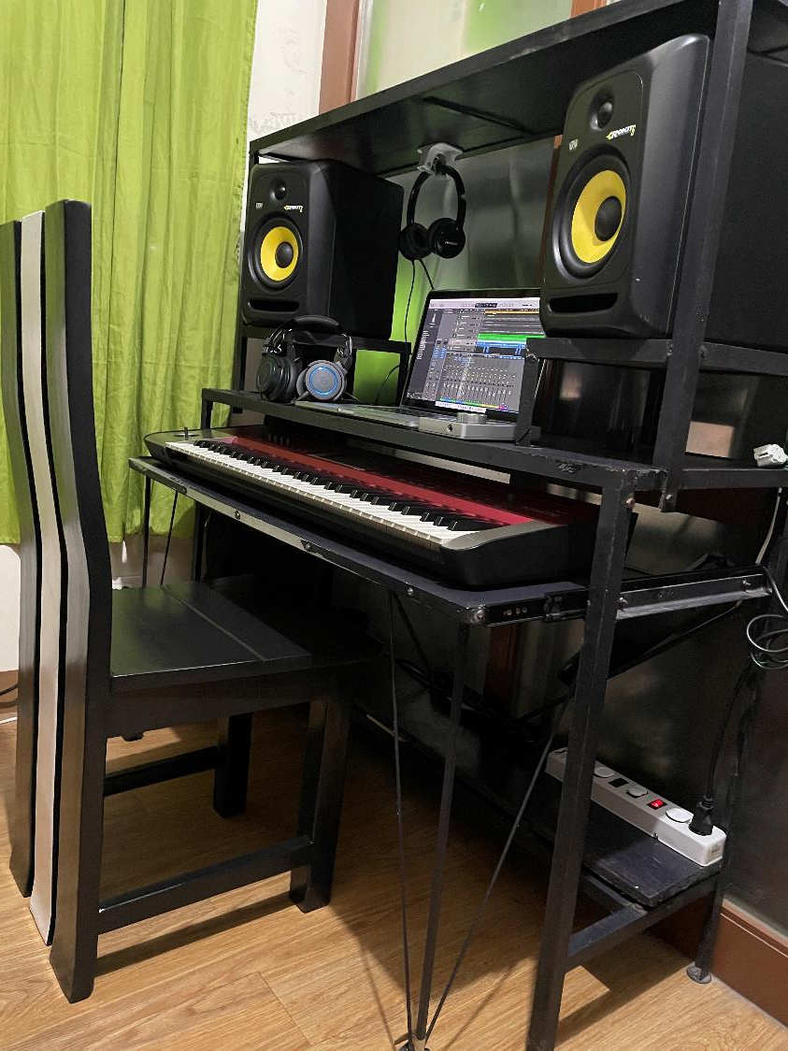
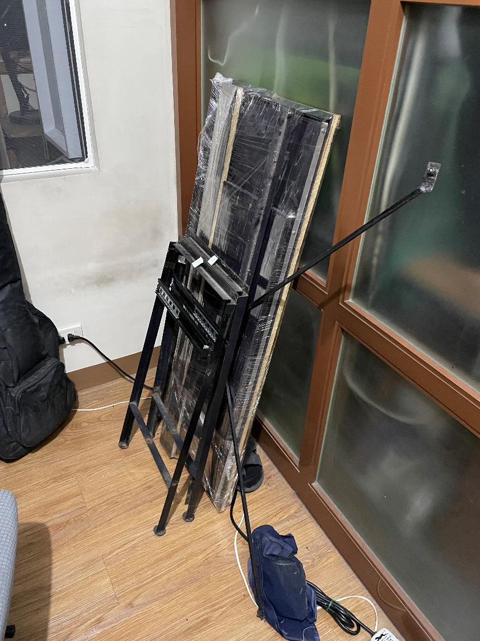
WHEN DISASSEMBLED…
Notes:
Design is modular, Made of angular bars at plyboard, welded by my father and me
Can be disassembled for easy transport

Slide 4
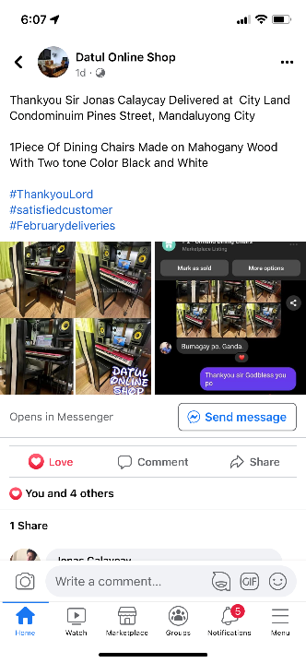

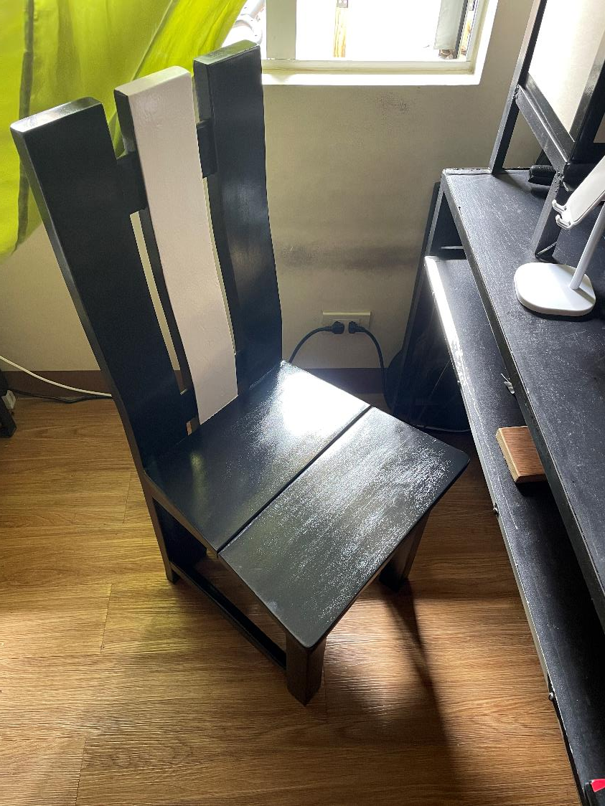

Notes:
Table is bought to a wood shop
Why I decided to design another desk?
Problem: Current desk is too high at 85cm, Its not ergonomic (should be 73 ~ 75cm only). masakit sa balikat sa katagalan

Slide 5
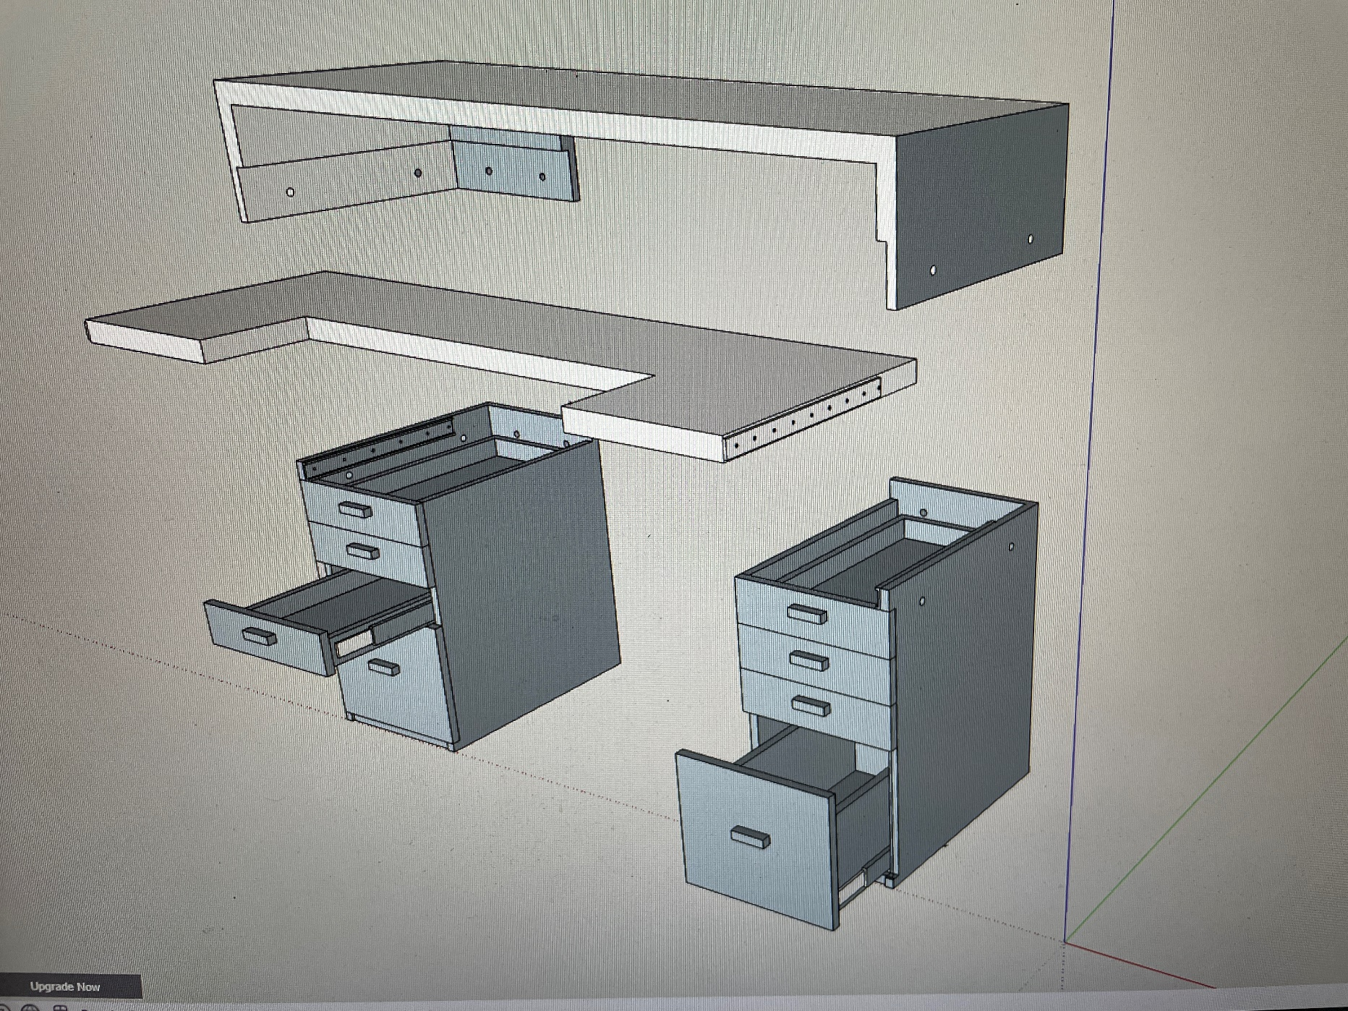
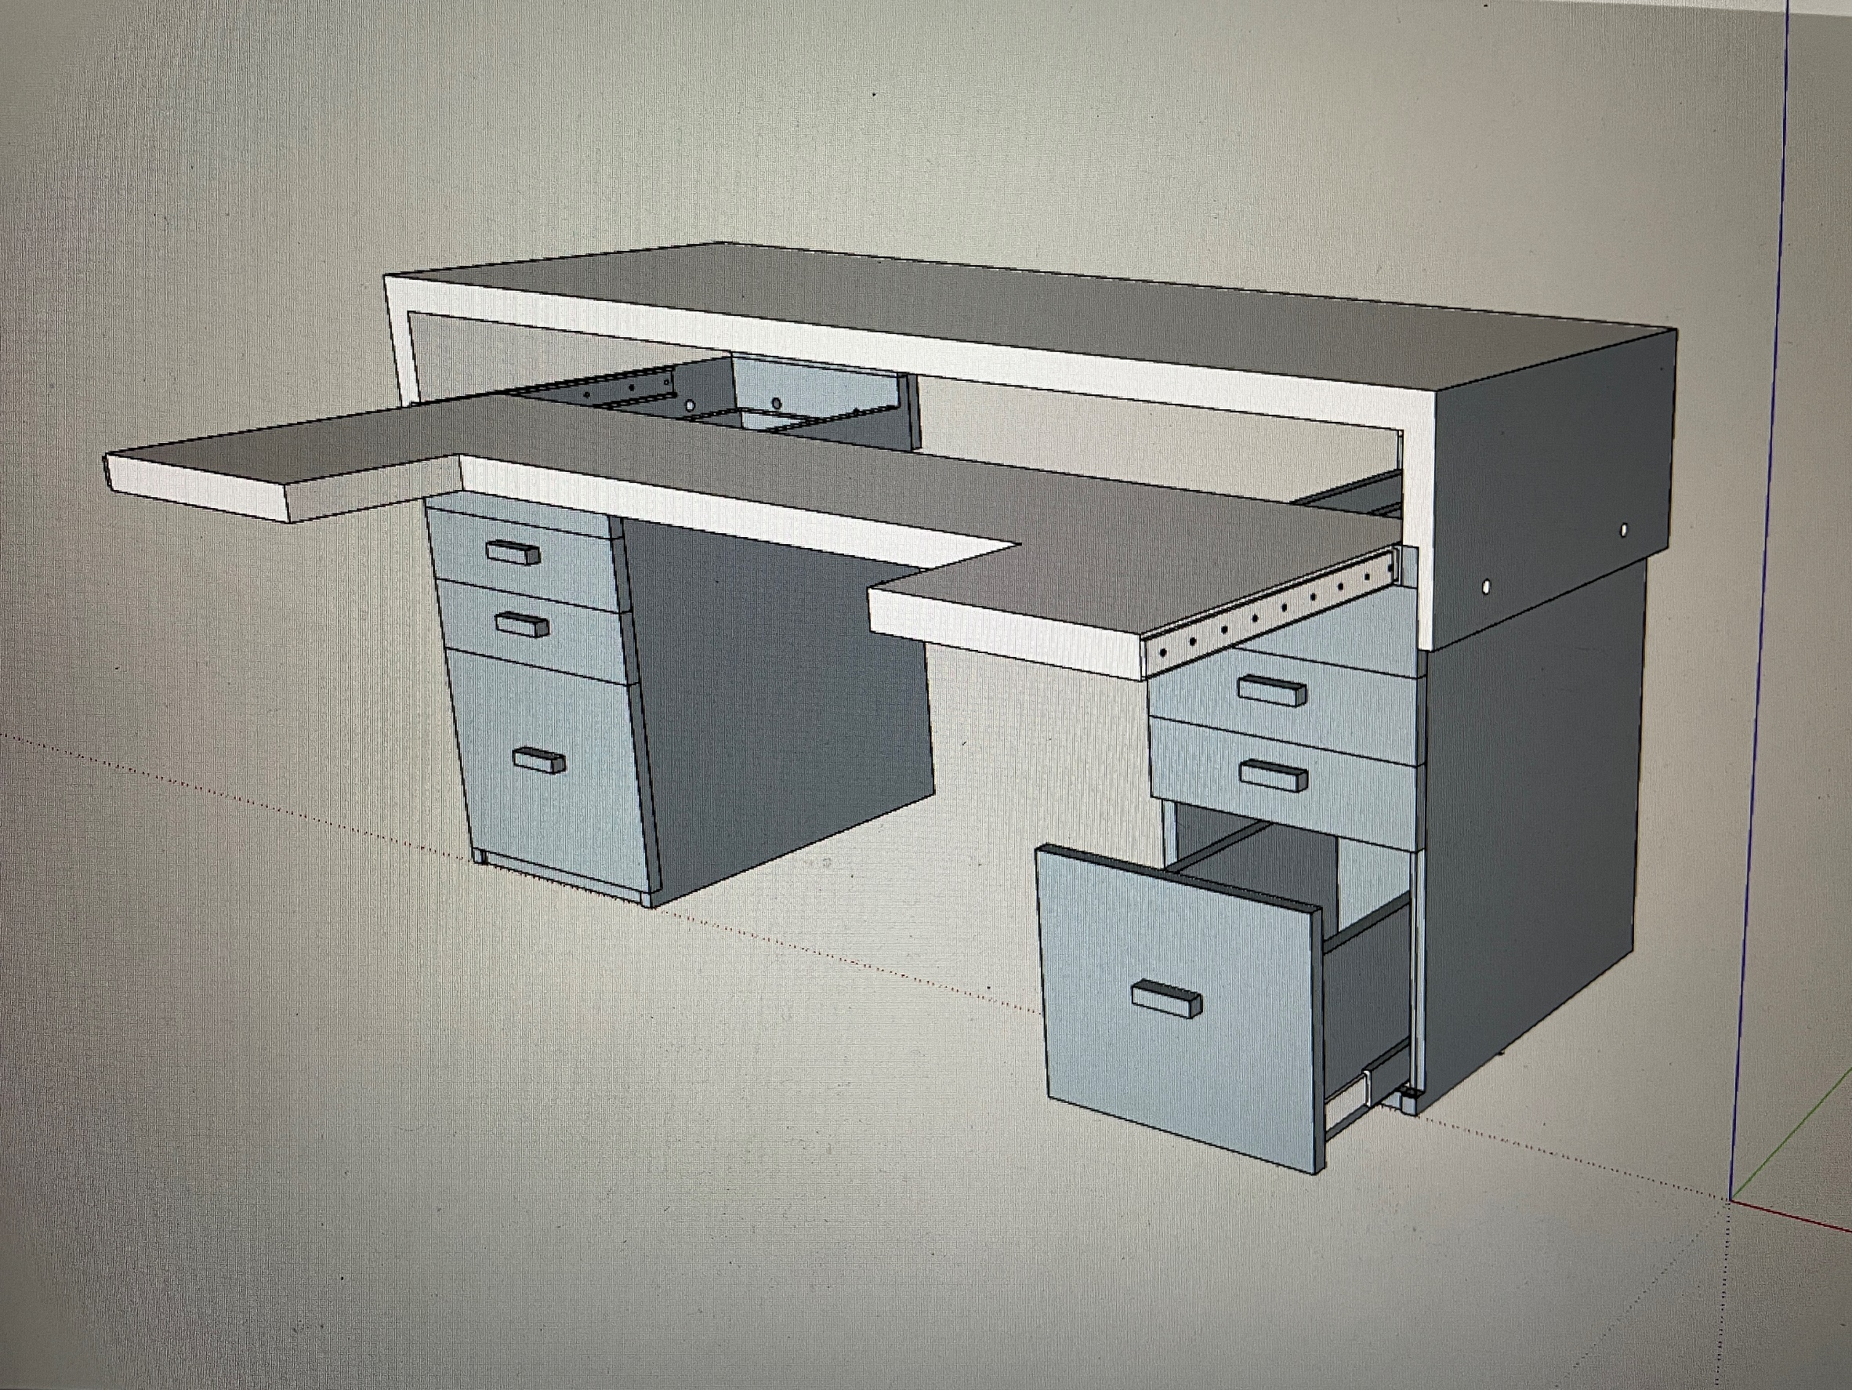
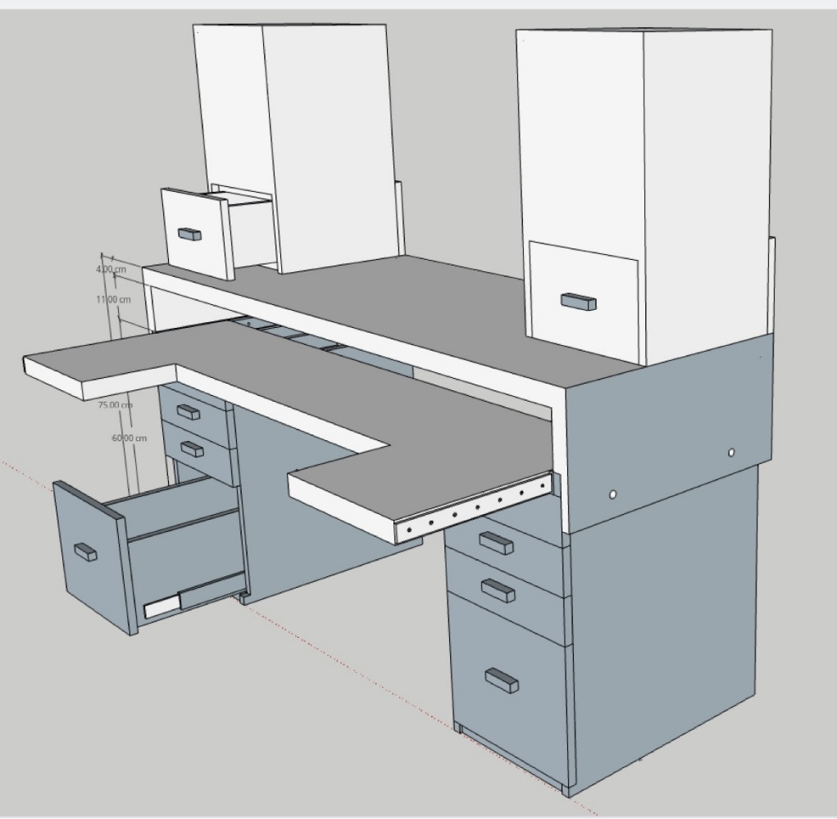
Notes:
2nd desk design with exploded view and speaker cover
Will be made of ¾” plywood, could be glued together to achieve the desired thickness
Rejected because it’s difficult to instruct the design to the wood shop

Slide 6
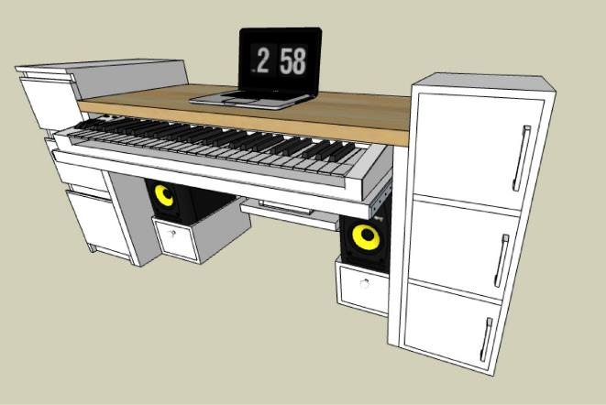
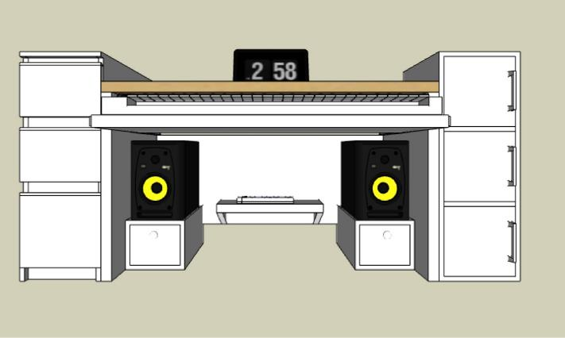
Notes:
Final design (isometric view and 3D front view (first configuration)

Slide 7
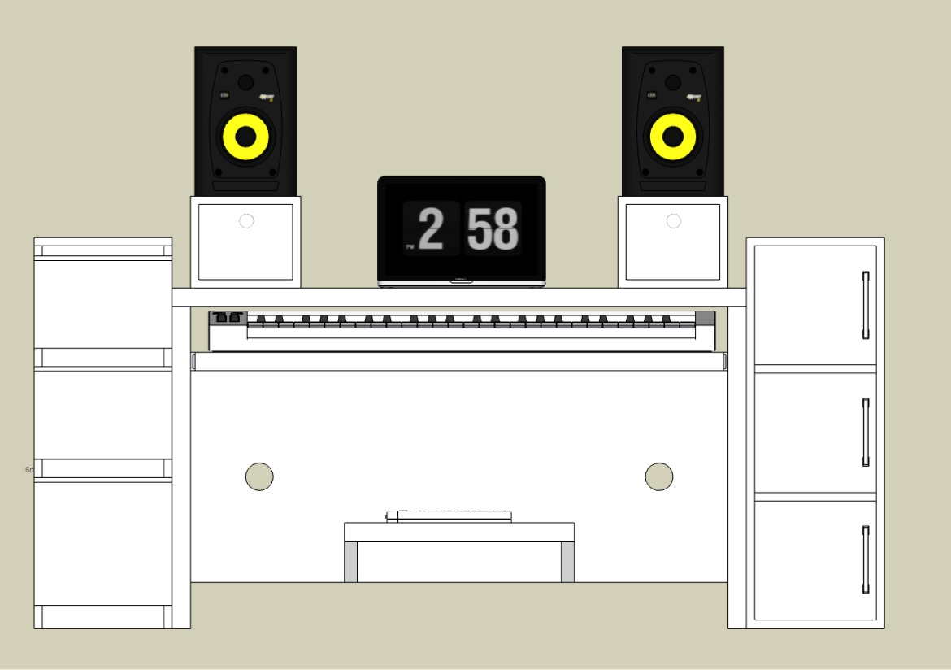
Notes:
2nd configuration

Slide 8
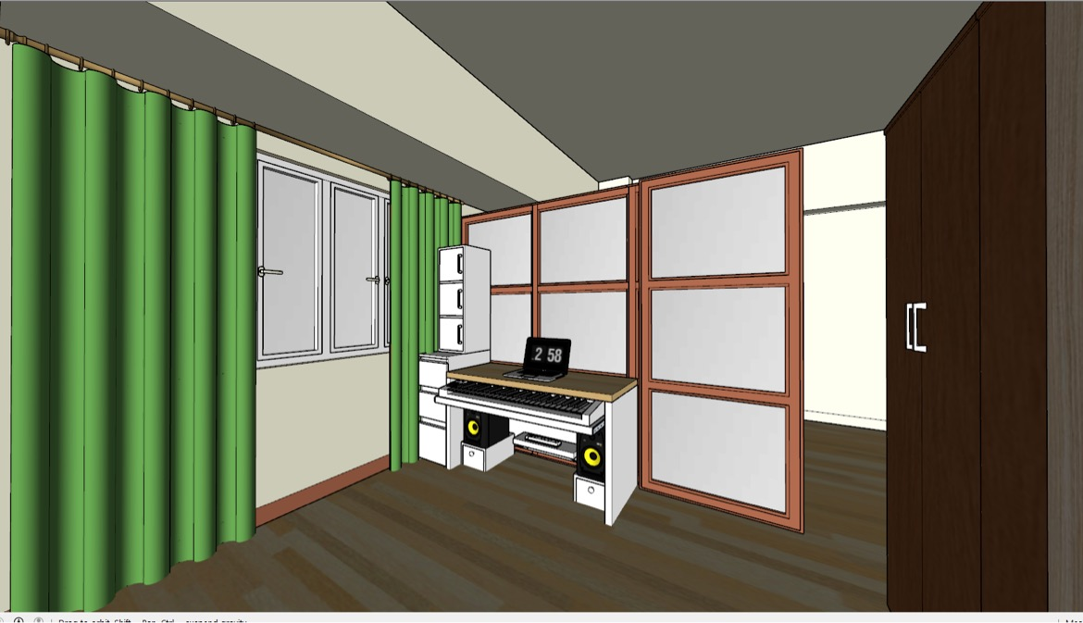
Notes:
Explain why the dimensions are decided. Cabinet 1 vs cabinet 2 depth,

Slide 9
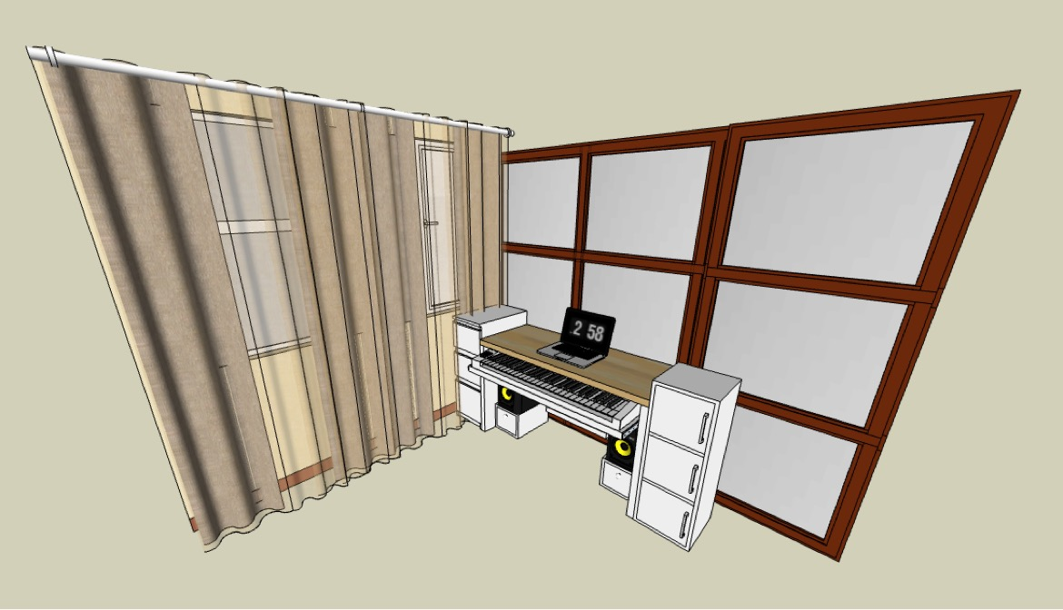
Notes:
Current config used

Slide 10
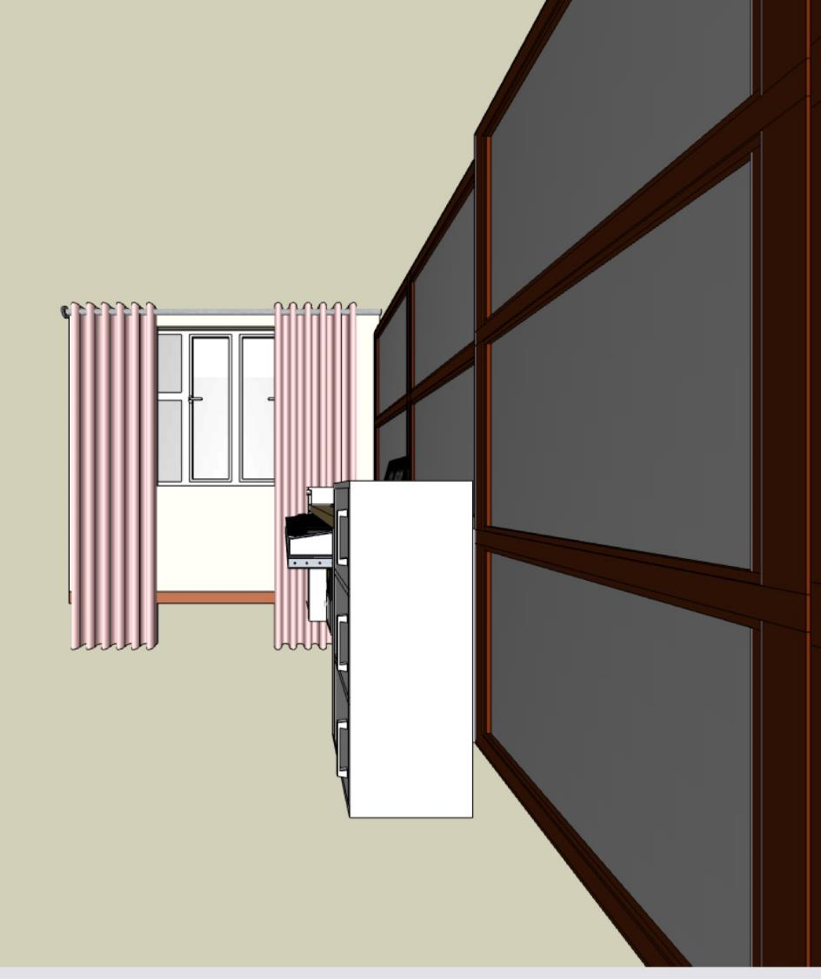
Notes:
Reason why the 2nd cabinet dept is shallow

Slide 11
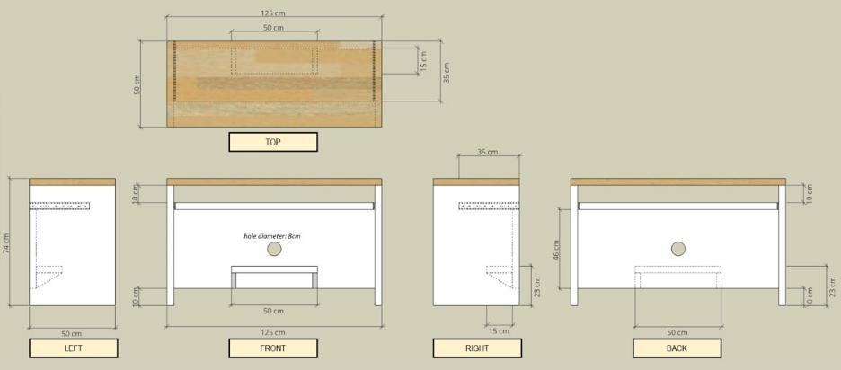
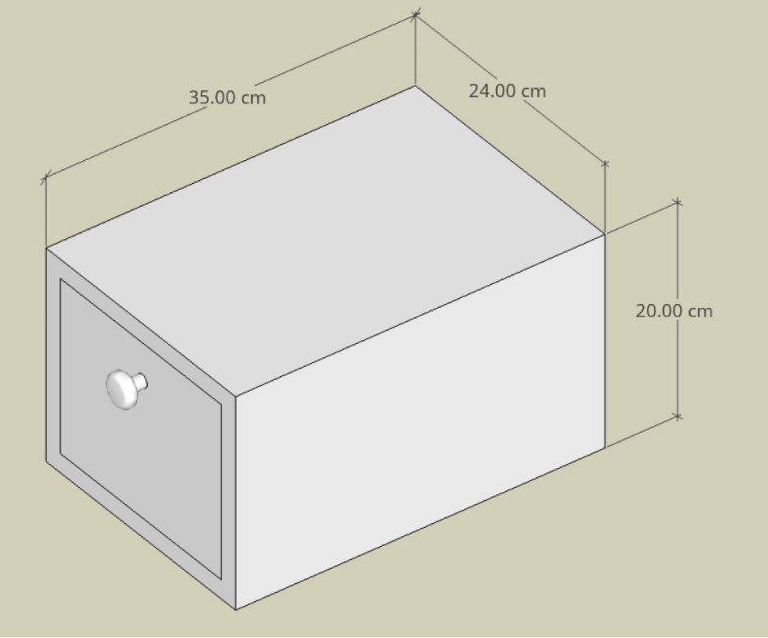
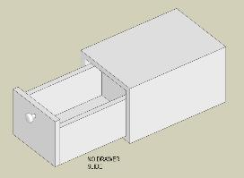
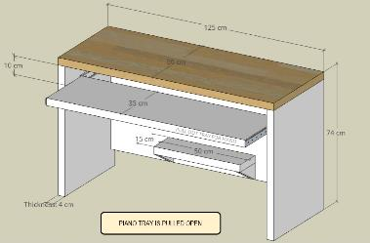
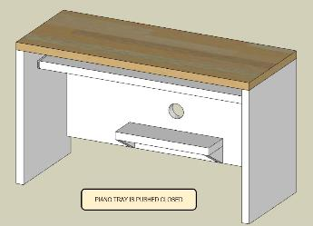
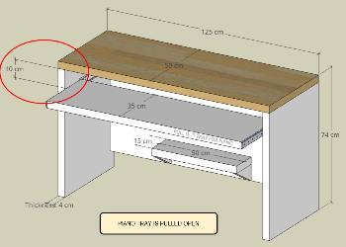
Notes:
Dimensions isometric/orthographic

Slide 12
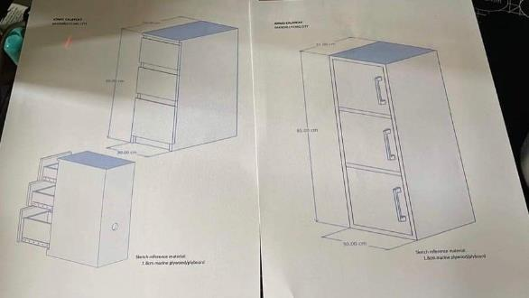
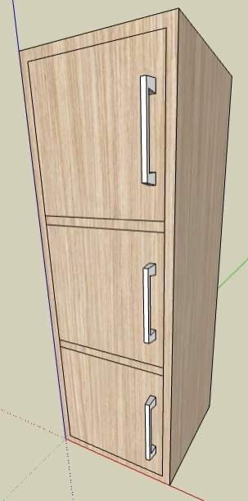
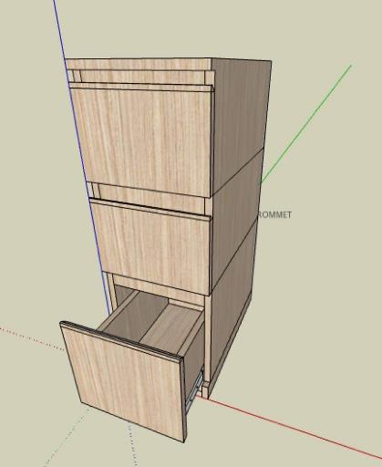
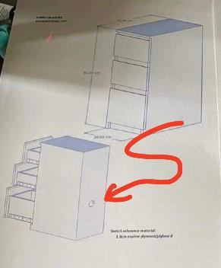
Notes:
Initial design and canvassing

Slide 13
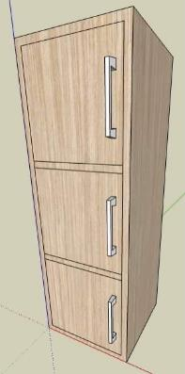
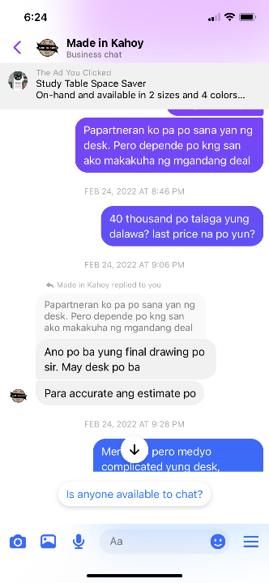
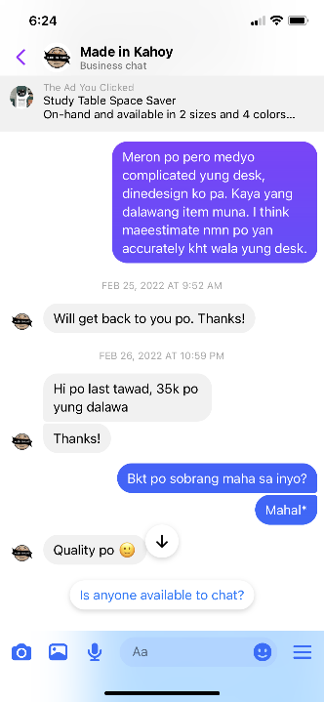
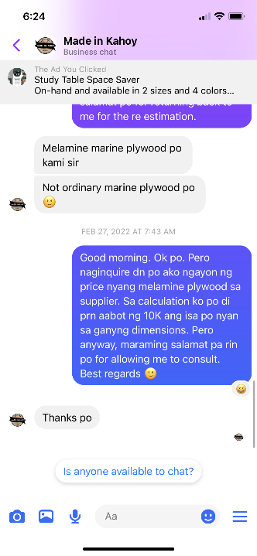
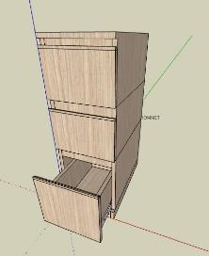
Notes:
Story of 1st inquiry

Slide 14
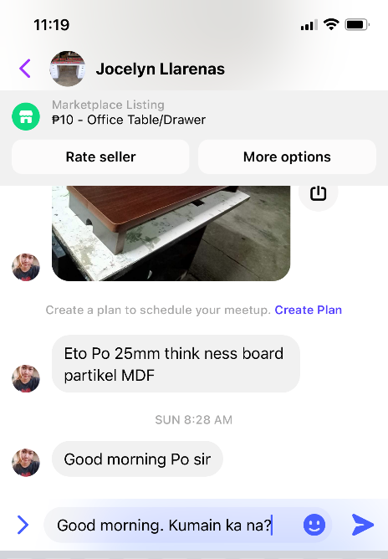
Notes:
2nd inquiry

Slide 15

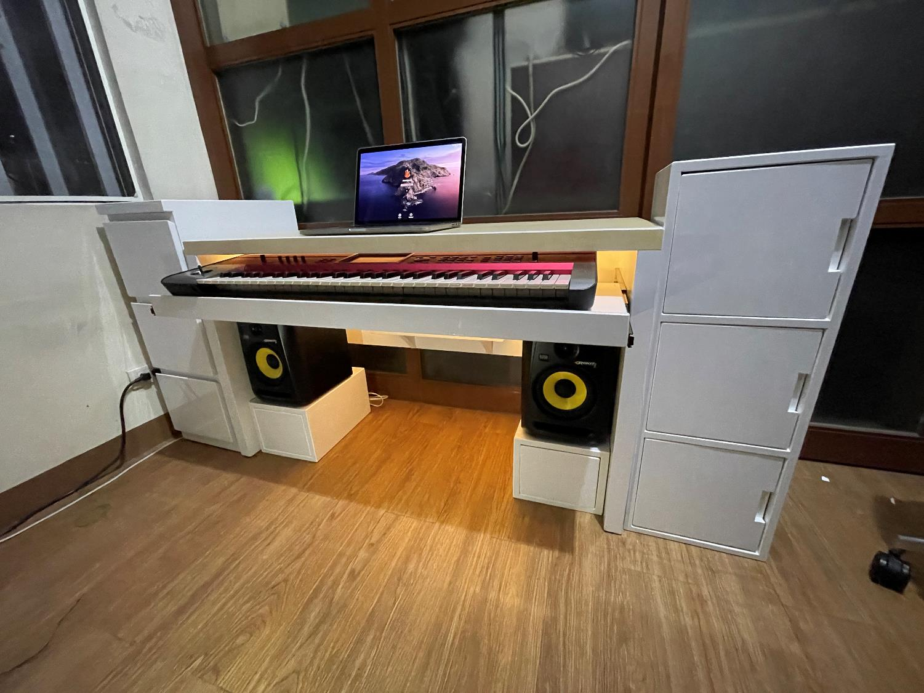
Notes:
Finished product.
Then, next project, decided to make it on my own, first project is on the next slide

Slide 16
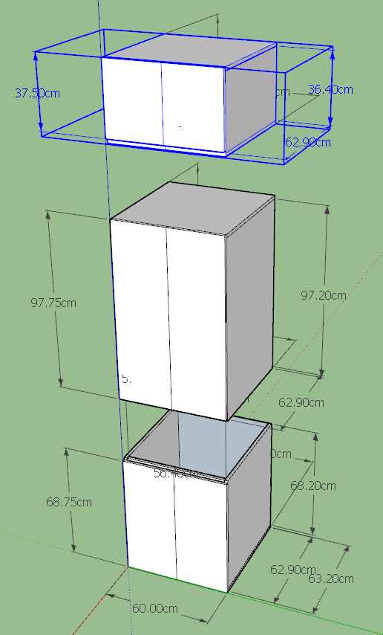
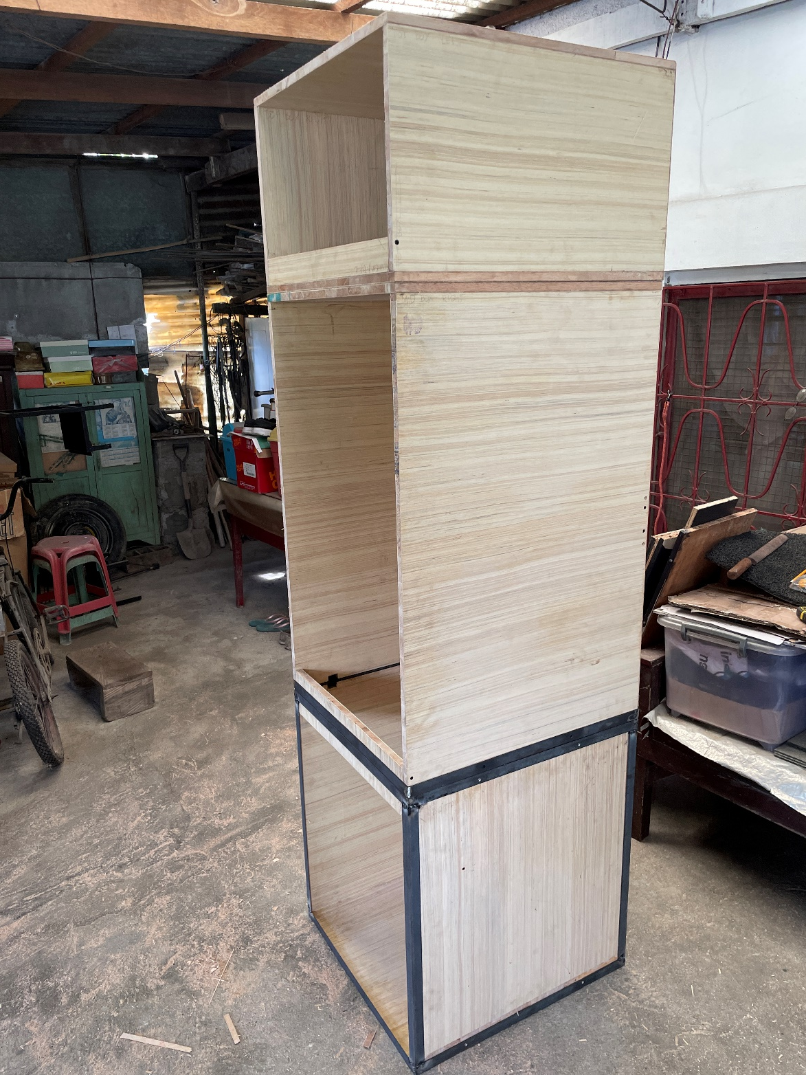
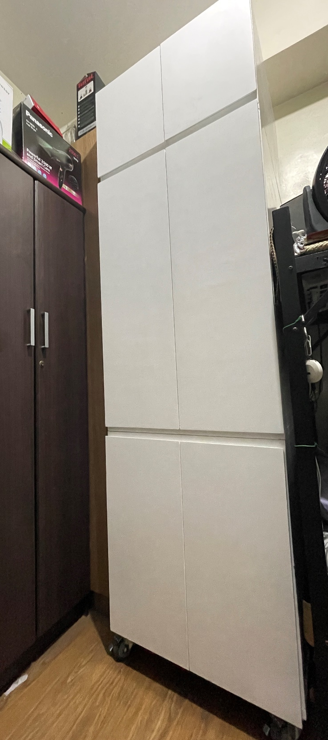
Notes:
Why it was designed in 3 segments? To store long objects, and so that it can be transported using Toyota innova.
Discuss the mistake in cutting

Slide 17
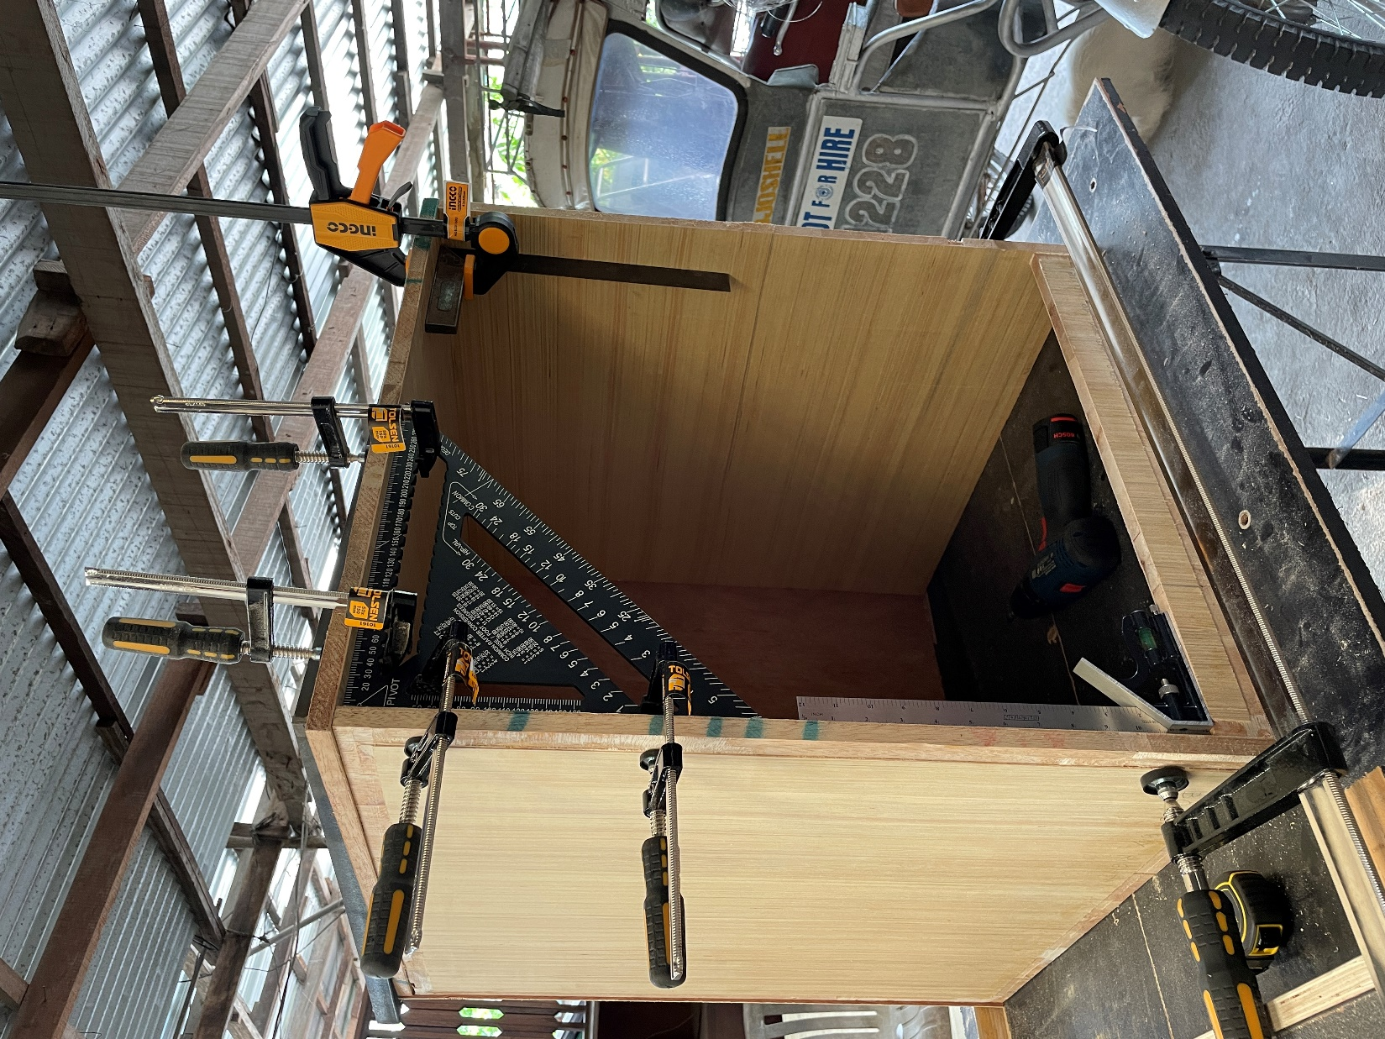
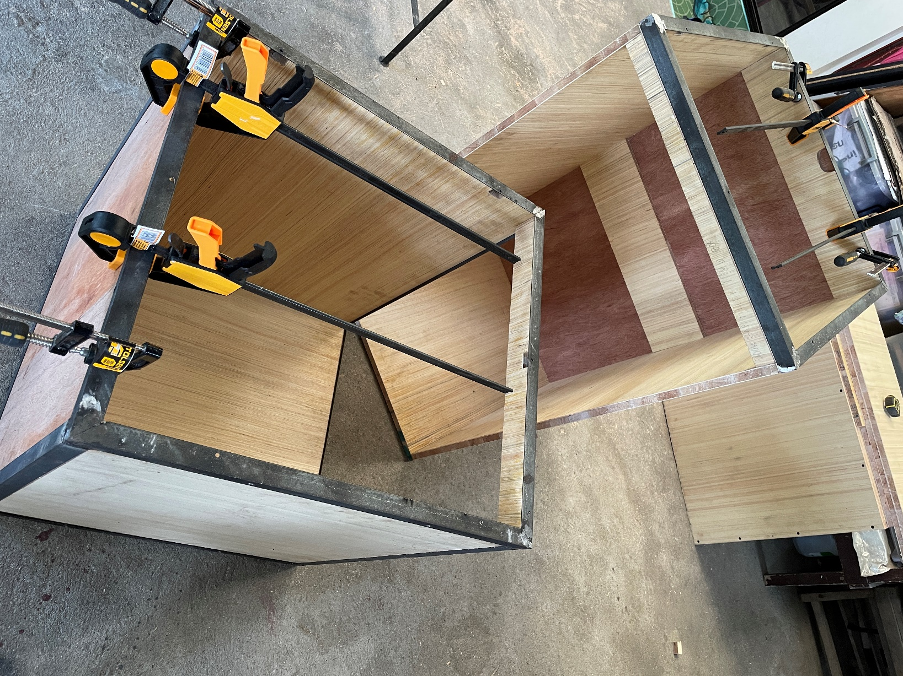
Notes:
Why is there an angular bar support?

Slide 18
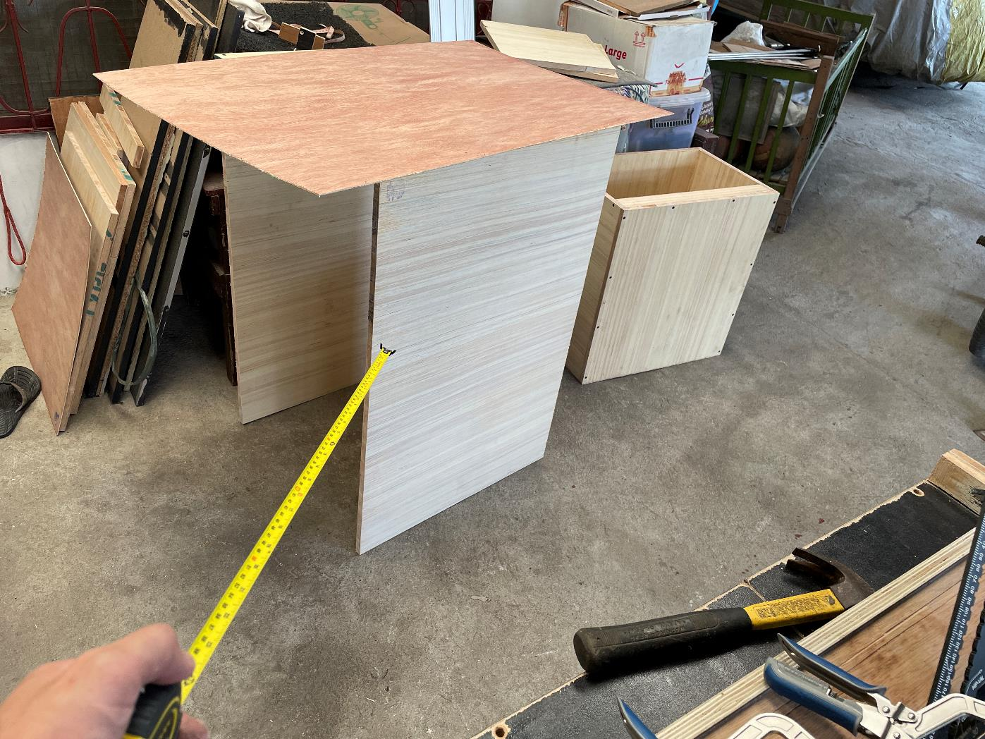

Slide 19
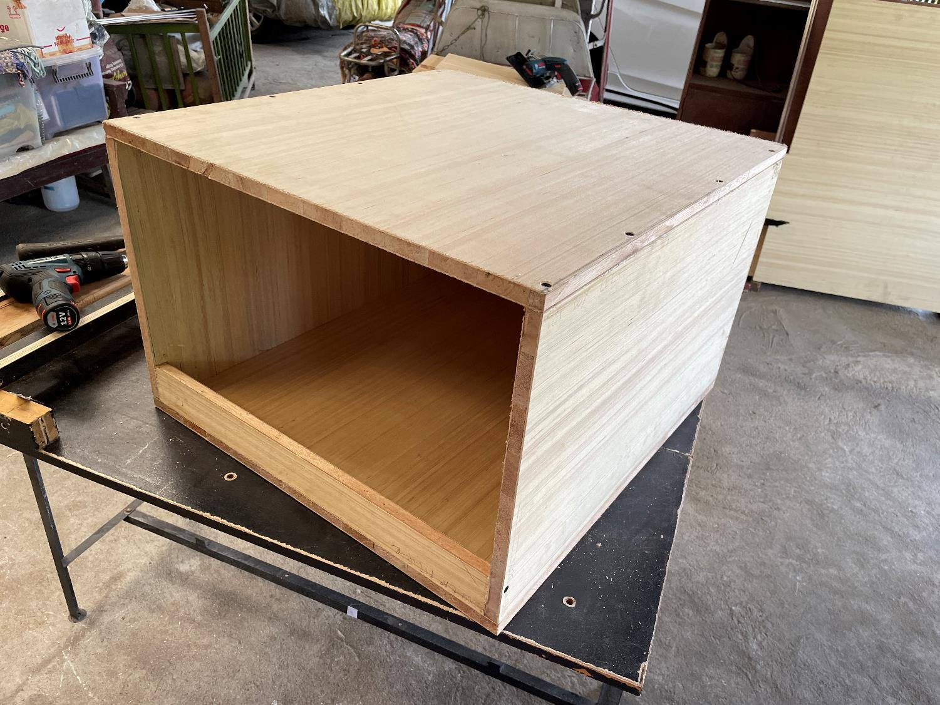

Slide 20
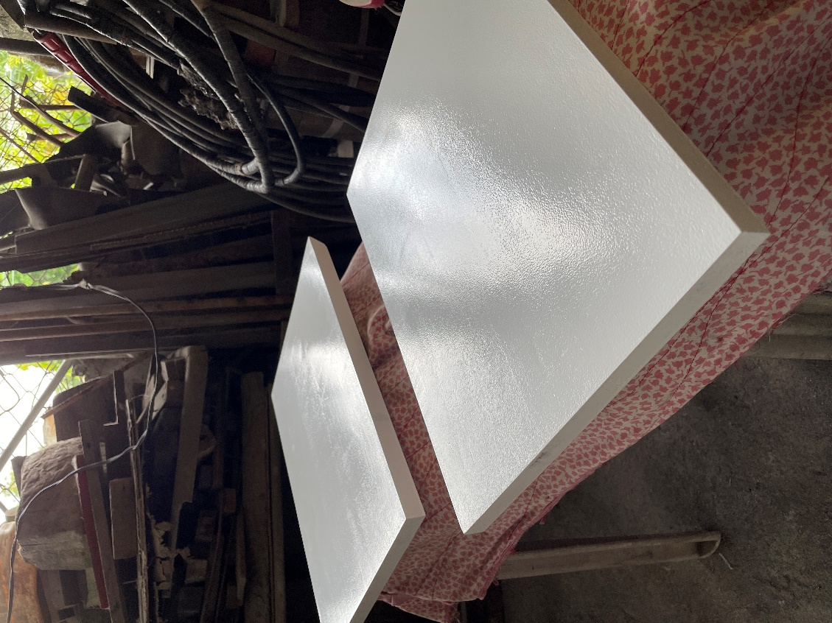
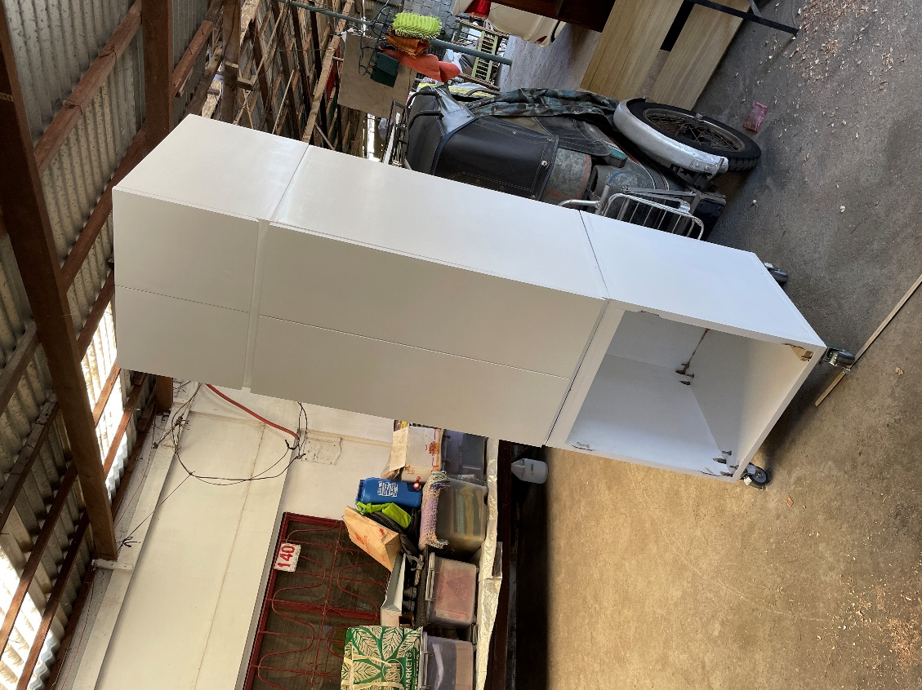
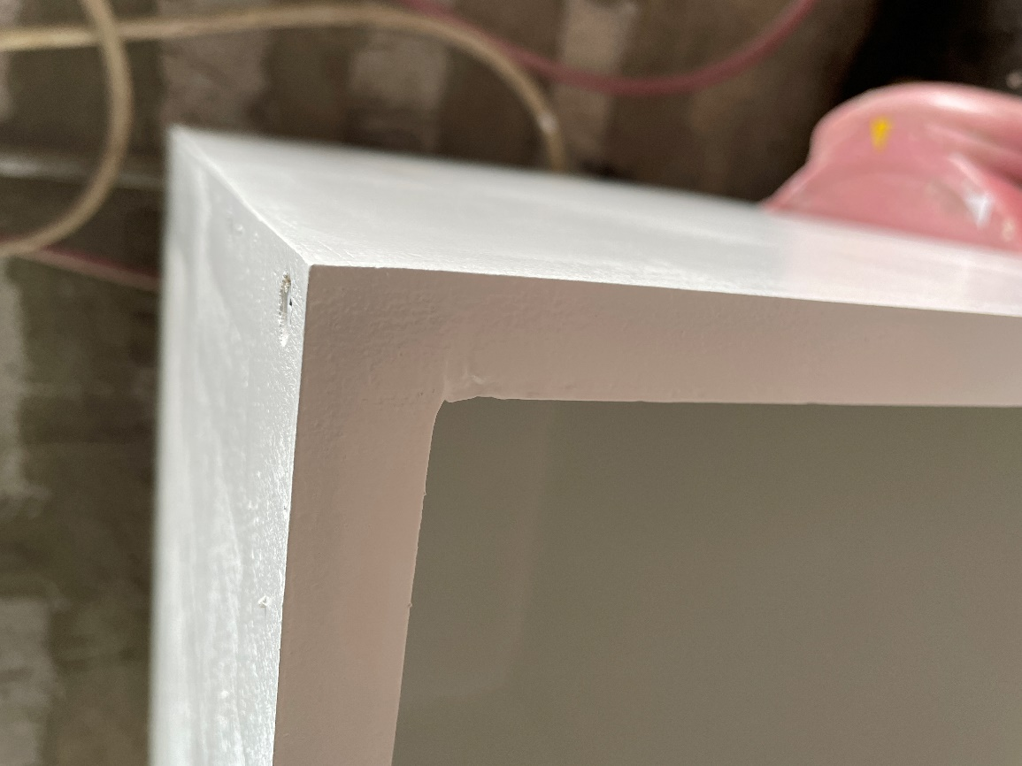
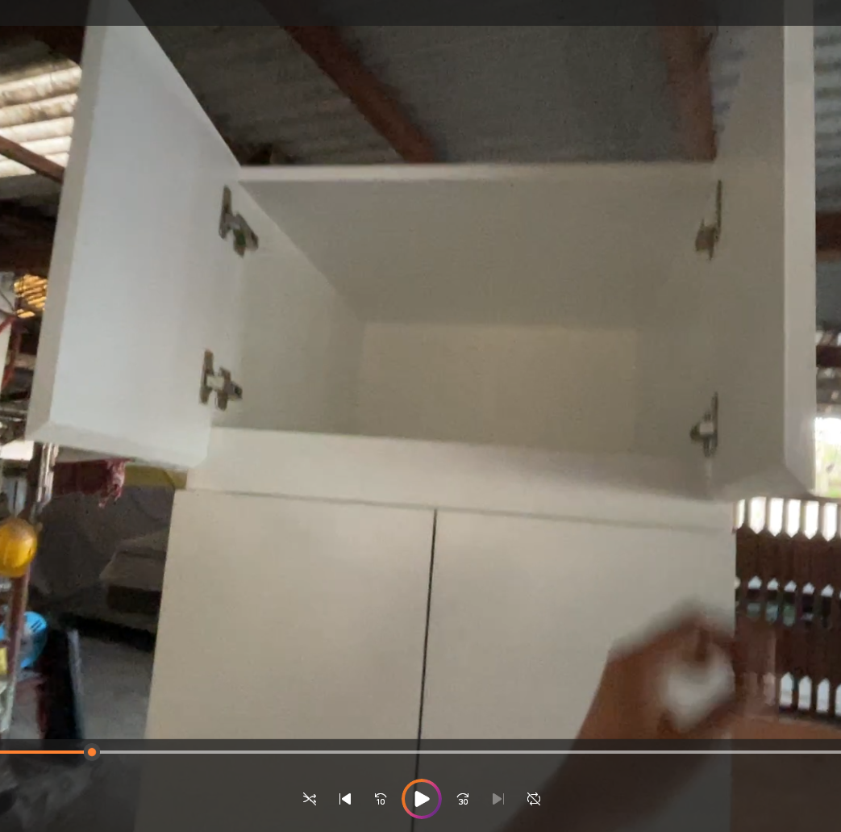

Slide 21
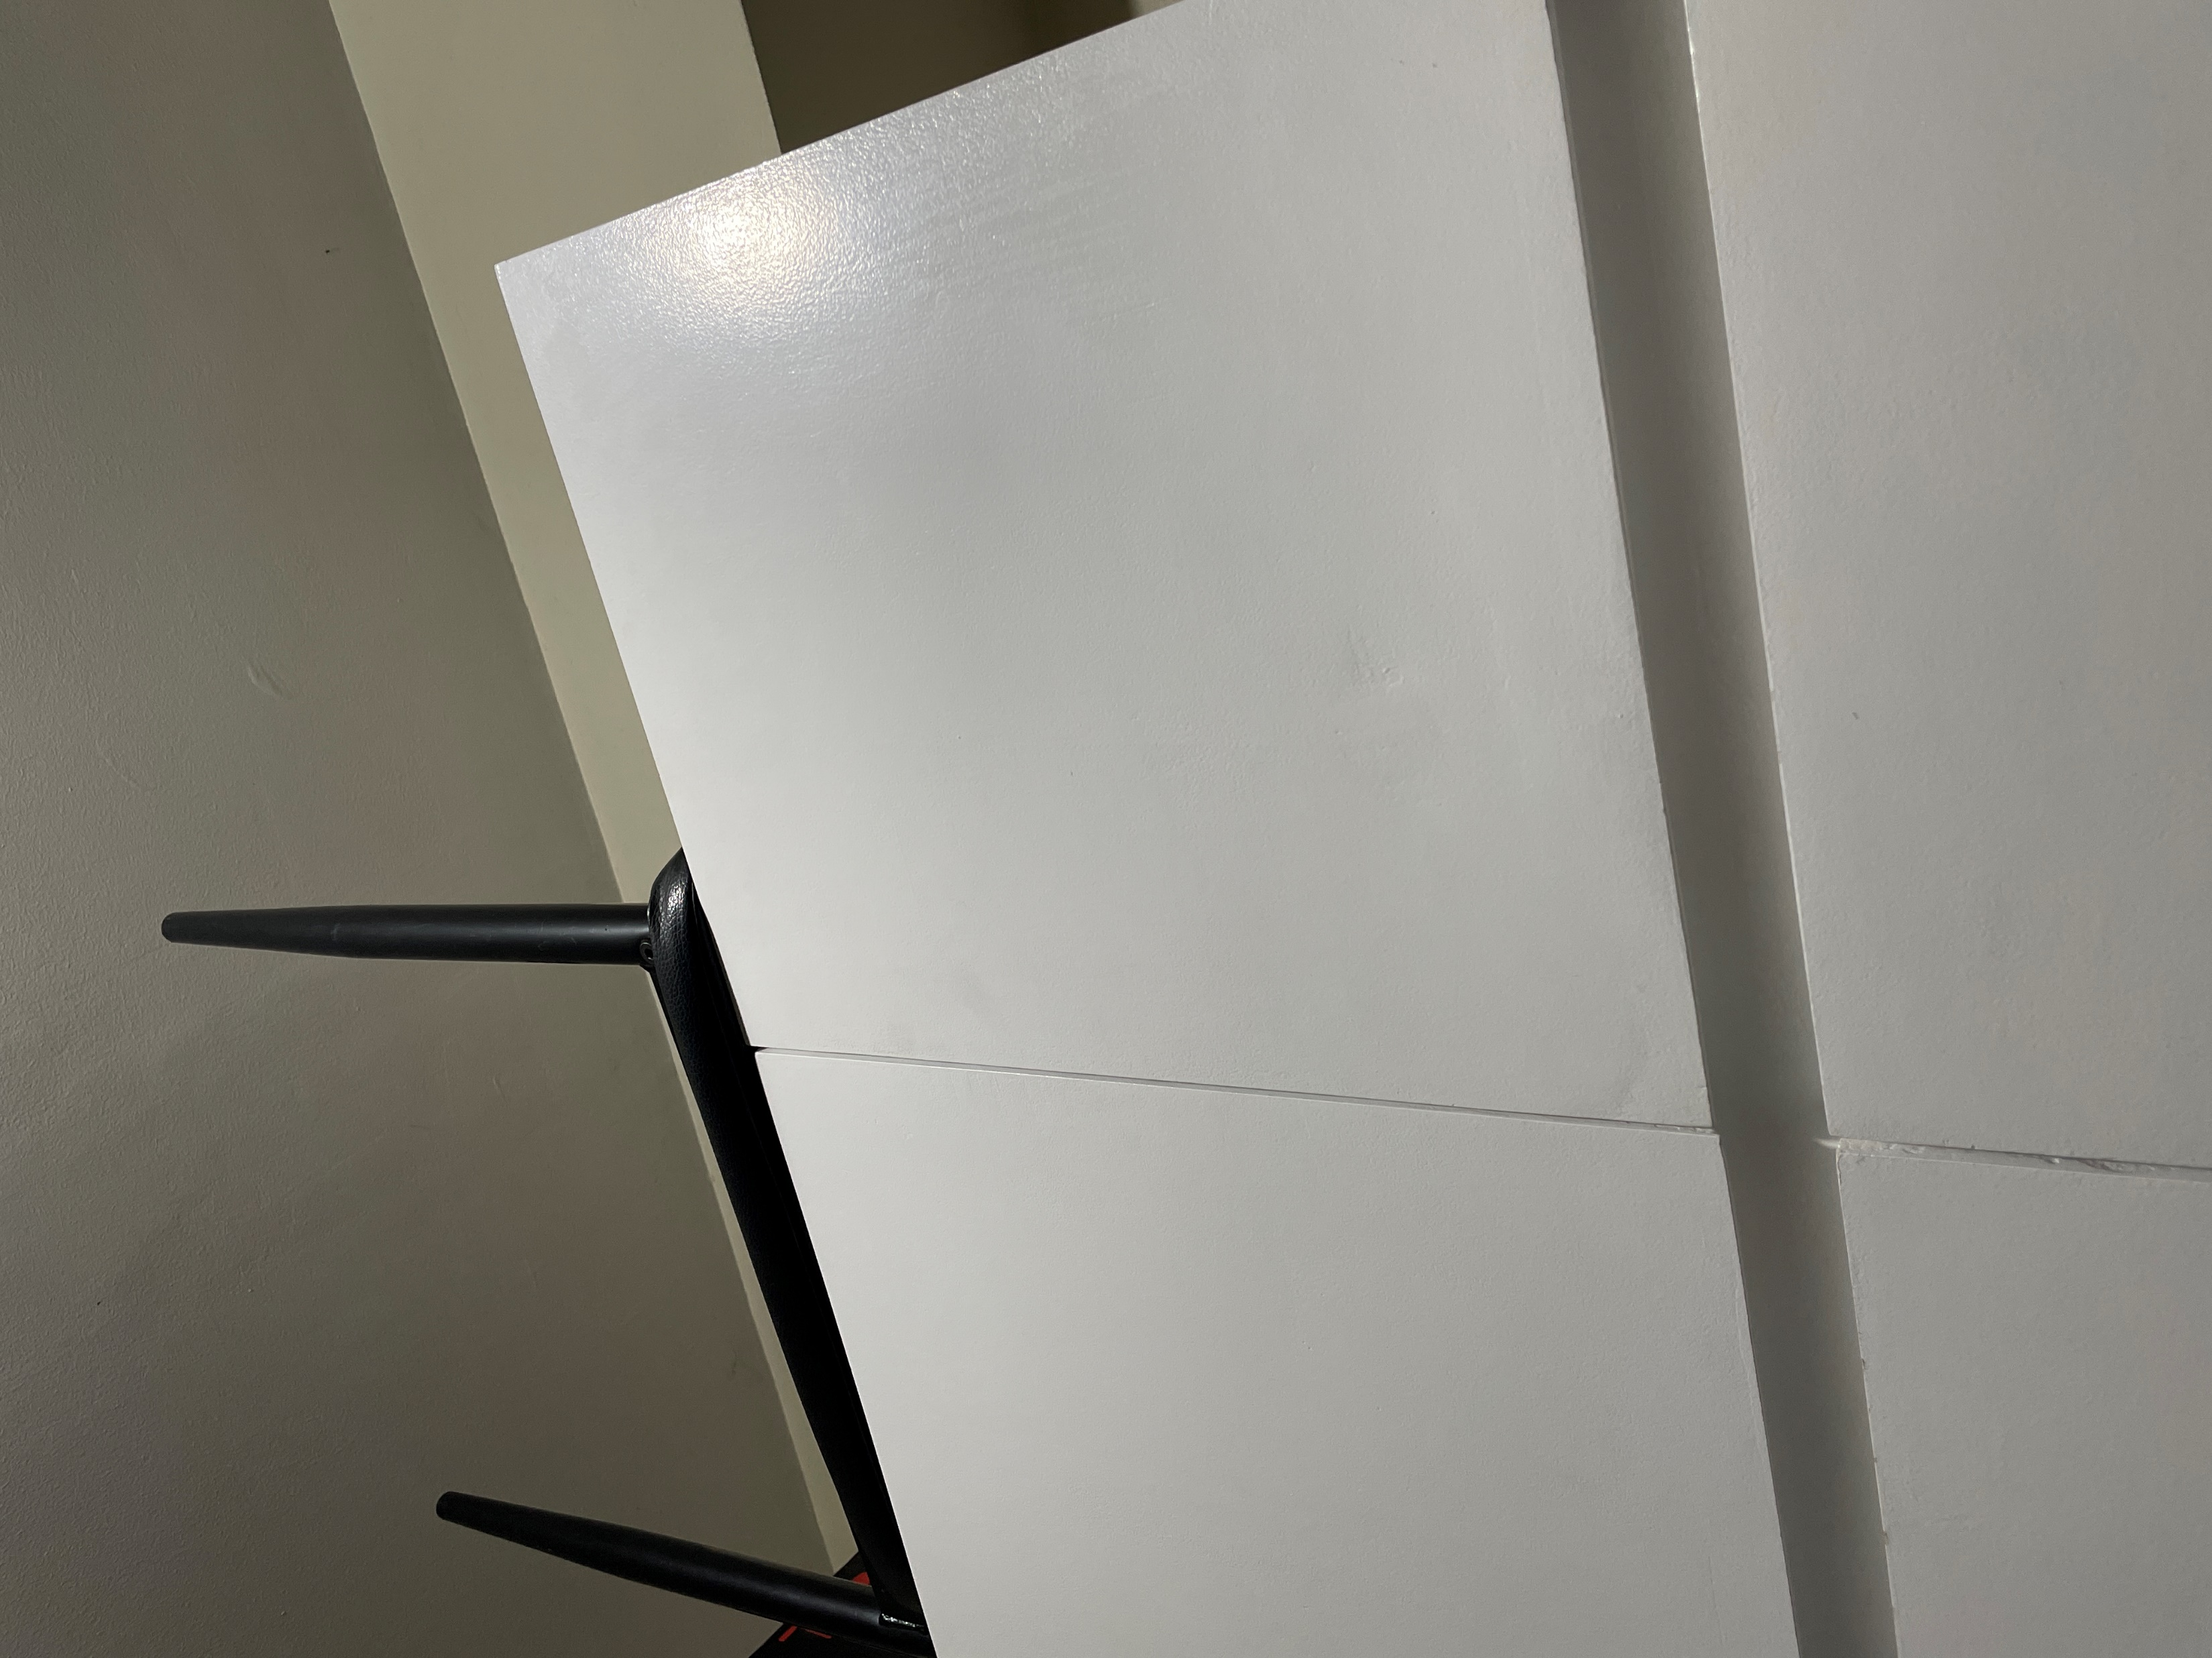
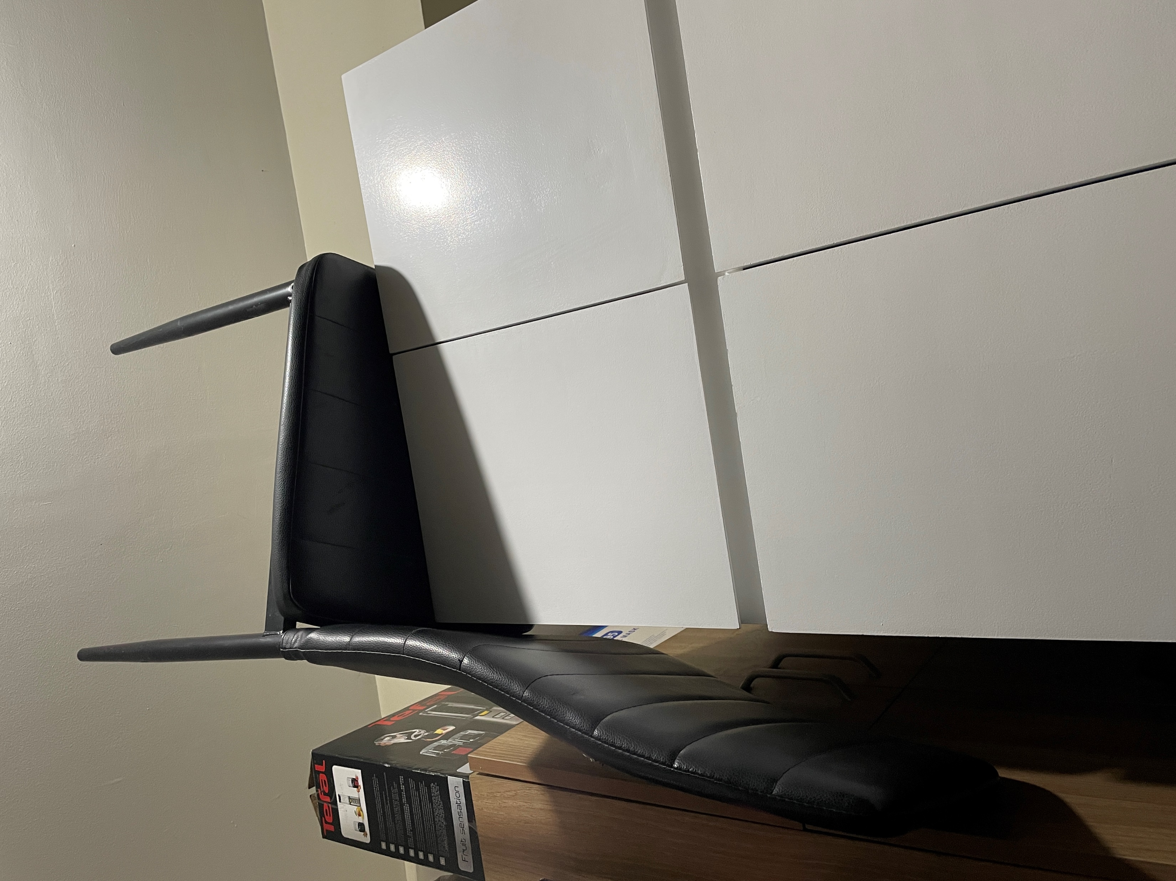

Slide 22
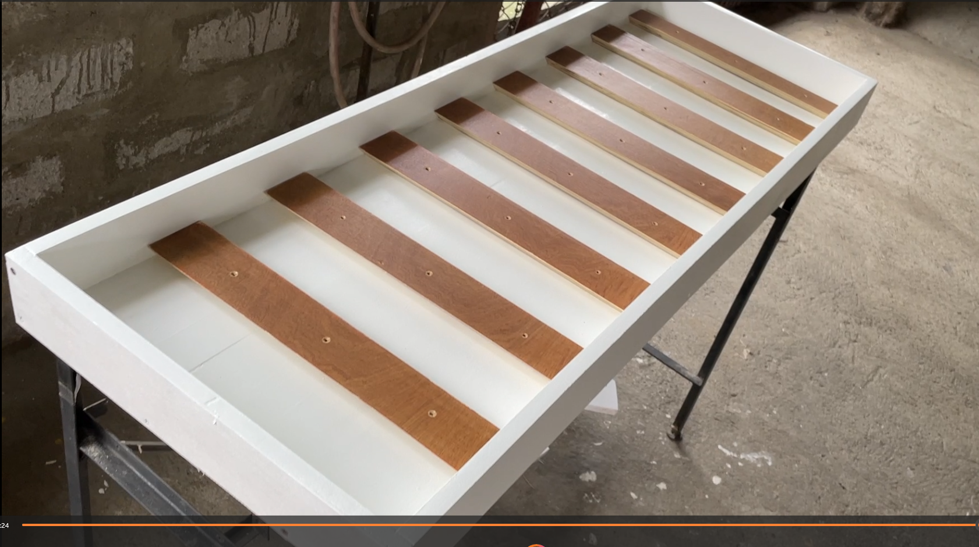
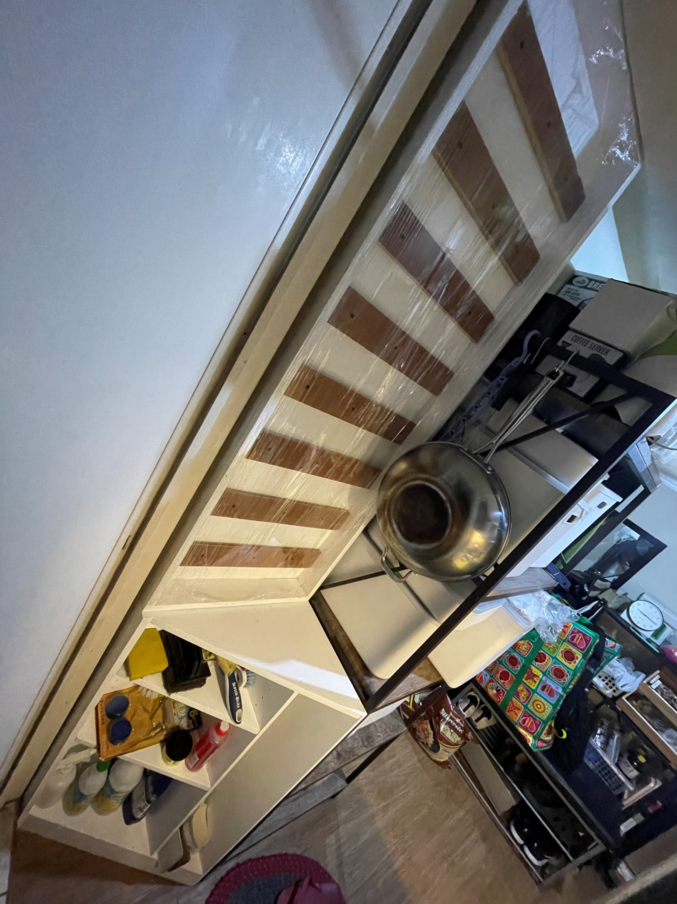
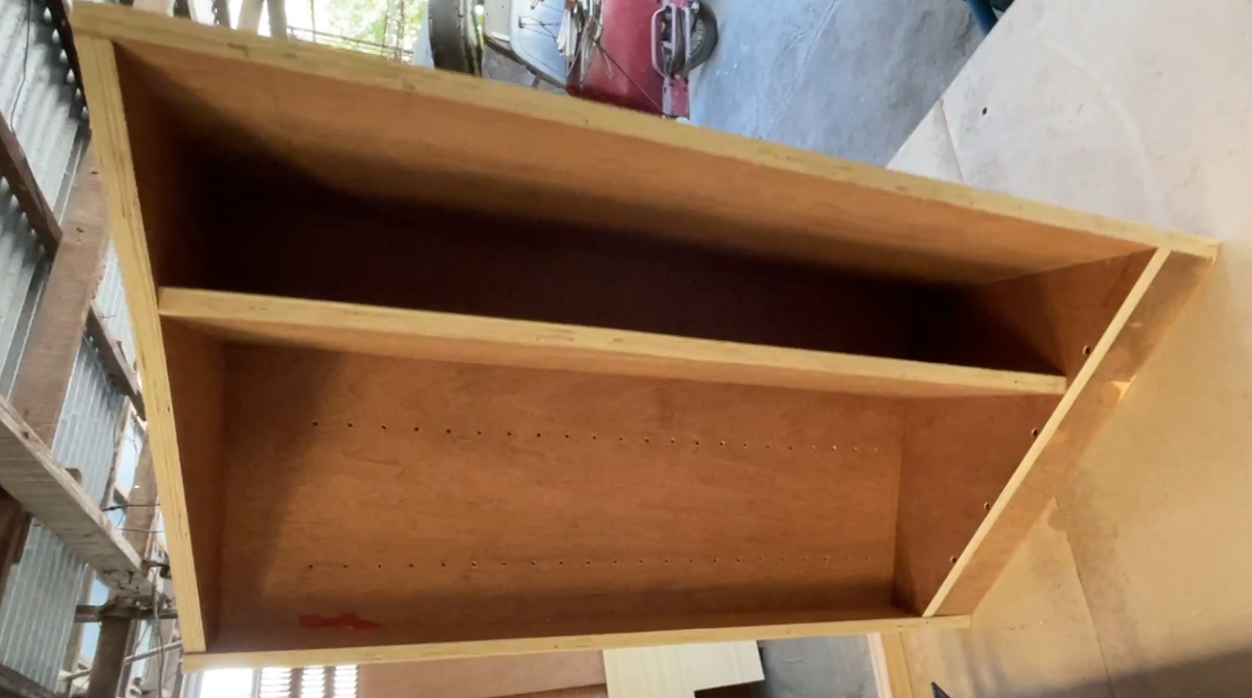

Slide 23
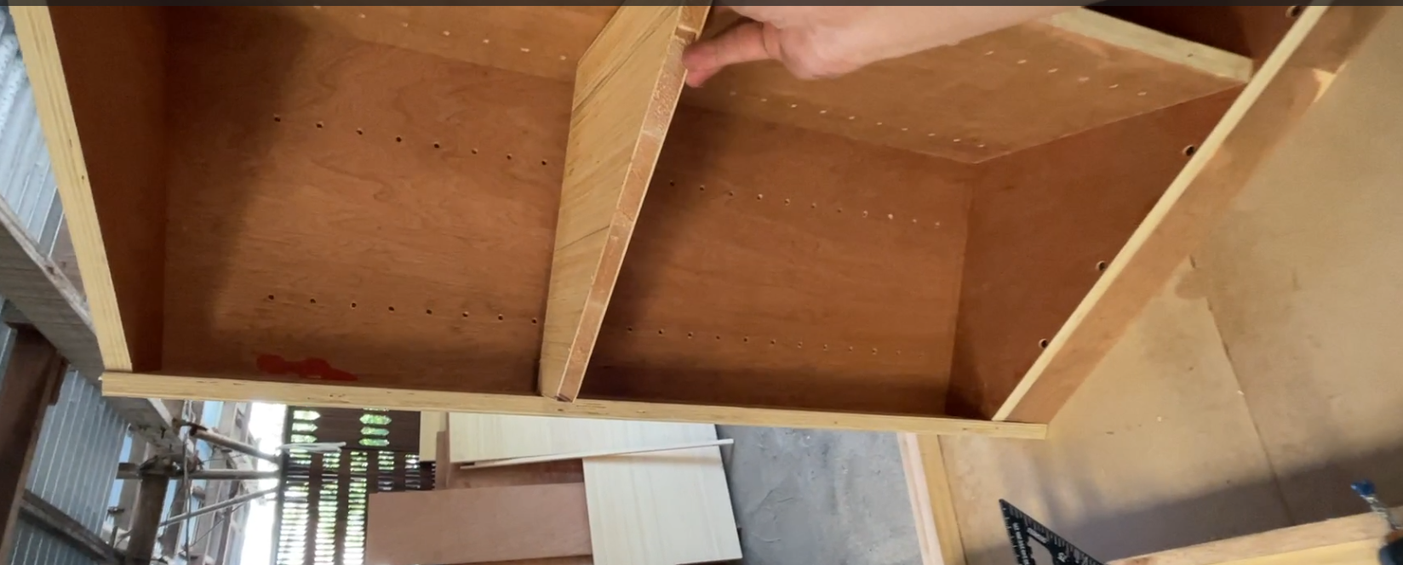

Slide 24


FRENCH CLEAT

Slide 25



Slide 26





Slide 27

Notes:
How to check if the box is square?

Slide 28


Slide 29



Slide 30




Slide 31



Slide 32



Slide 33




Slide 34



Slide 36






